Slide 1
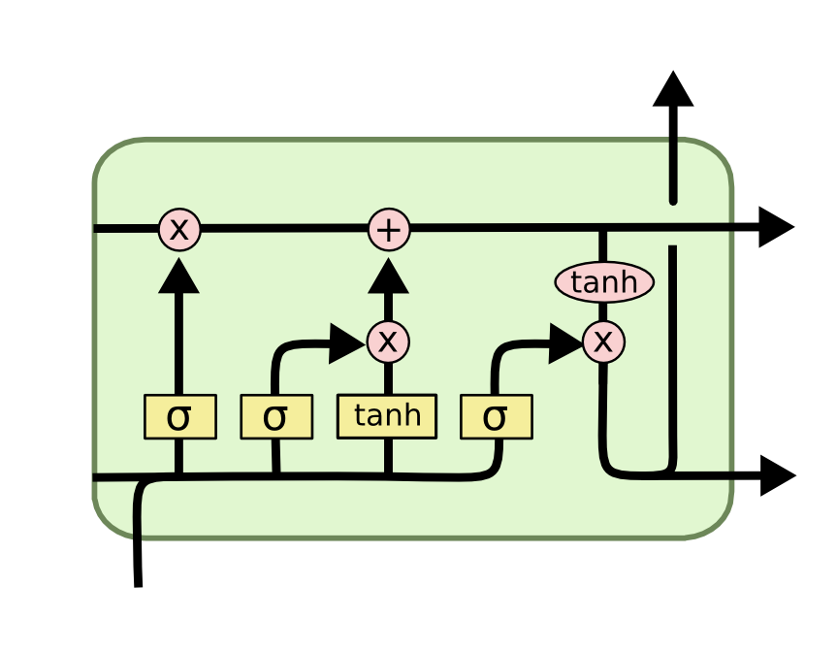
Long Short Term Memory (LSTM)
Notes:
1

Slide 2
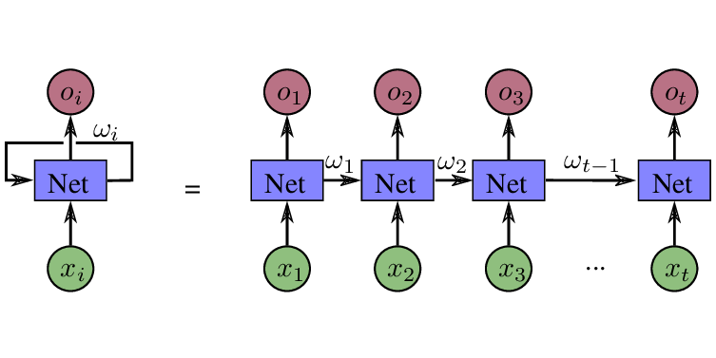
RNN
Image Courtesy: researchgate.net

Slide 3
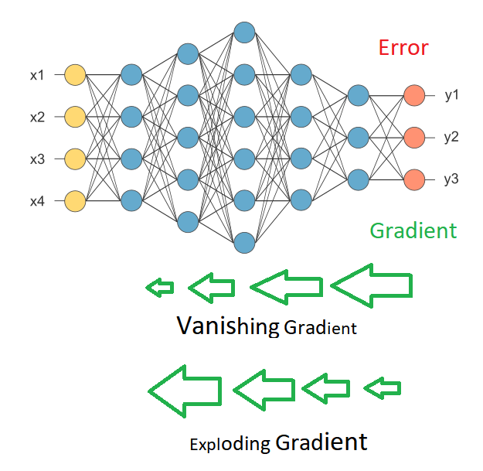
Vanishing Gradient Problem
Image Courtesy: medium.com

Slide 4
LSTM
Image Courtesy: colah.github.io

Slide 5
LSTM
Image Courtesy: colah.github.io

